Slide 1
ALGORITHMIC DIFFERENTIATION (AD)
PART I
Ian Fenty
Shreyas Gaikwad

Slide 2
Goals for this talk
Part I (Theory)
Reintroduce adjoints in a slightly different context
Hopefully show a different way of looking at adjoints
Part 2 (Example)
Work through how Algorithmic Differentiation (AD) actually works in theory and practice
Apply these concepts to a simple 1D climate model

Slide 3
Utility of gradients
The adjoint operator can help us get gradients for our quantity of interest (QoI) with respect to any independent controls such as initial and boundary conditions, model parameters, etc.
Sensitivity Analysis
State Estimation
Uncertainty Quantification
Optimal Experimental Design (what is the most optimal location for new sensors for maximum new information gain)

Slide 4
MATHEMATICAL NOTATION
A: Matrix
x: vector
A and f: (potentially) non-linear functions
J and z: Scalar

Slide 5
Non-Linear Forward Model
y = A(x)
J = f(y)
This is the model we are working with. It could be an ocean model like the MITgcm or an ice sheet model like SICOPOLIS or ISSM.
In a general sense, the model can be expressed as a non-linear function.
x is a (uncertain) vector of “controls” (initial / boundary conditions, model parameters)
A is a non-linear model (time-stepping ocean / ice-sheet model)
y is the final model state
J is a scalar quantity of interest (QoI), could be some model-data misfit, could be something like projected sea level rise, or transport quantities like the AMOC. It is a function of the final state y.

Slide 6
How to get the gradients of J with respect to x?

Slide 7
Method 1: Perturb one x at a time (Finite Differences)
y = A(x)
J = f(y)
Let’s perturb one component of x at a time and observe the resulting change in J.
Perturb the i-th component of x: xᵢ⁺ = x + ε · eᵢ, where eᵢ is a unit vector in the i-th direction and ε is a small scalar. That will change the value of y to yᵢ⁺ and J to Jᵢ⁺.
∂J/∂xᵢ ≈ [Jᵢ⁺ - J] / ε
∂J/∂xᵢ ≈ [f(yᵢ⁺) - f(y)] / ε
∂J/∂xᵢ ≈ [f(A(xᵢ⁺)) - f(A(x))] / ε
∂J/∂xᵢ = [f(A(xᵢ⁺)) - f(A(x))] / ε + O(ε)

Slide 8
Method 1: Finite Differences (Perturb one x at a time)
y = A(x); J = f(y)
xᵢ⁺ = x + ε · eᵢ
∂J/∂xᵢ ≈ [f(A(xᵢ⁺)) - f(A(x))] / ε + O(ε)
Drawbacks:
Requires N+1 calls of non-linear forward model for N-dimensional gradient wrt x.
Doesn’t scale well (N ~ 0.5 billion “controls” for ECCO).
Always has an error term proportional to some power of ε.
Choice of ε is hard: too large and the response might not be linear, too small and it leads to numerical round-off errors.
In practice, for different choices of ε, the values of the gradient can vary wildly.

Slide 9
Method 1: Finite Differences Example
y = x, J = y²
dJ/dx ≈ ((x+ε)² - x²)/ε
= (x² + 2xε + ε² - x²)/ε
= (2xε + ε²)/ε
= 2x + ε (slightly off)
Finite Differences (Method 1) uses the non-linear forward model as a black box and just perturbs the input and uses non-linear functional evaluations to approximate the directional derivative.

Slide 10
Method 2: Tangent Linear Model (Linearized Forward Model)
δy = ∂A/∂x · δx
∴ δy = A(x) · δx
We again have: y = A(x) and J = f(y)
We compute the directional derivative of y with respect to x using the tangent linear model. Let δx be a small perturbation in x. The corresponding perturbation in y is given by:
The matrix in purple is the Jacobian or the Tangent Linear Model (TLM). Then propagate δy to get the change in J:
δJ = ∂f/∂y · δy
∴ δJ = ∂f/∂y · A(x) · δx
This gives the directional derivative of J along δx. To compute full gradient ∂J/∂x, repeat for each unit vector δx = eᵢ

Slide 11
Method 2: Tangent Linear Model
y = A(x)
J = f(y)
δy = A(x) · δx
δJ = ∂f/∂y · δy
HARD TO GET
TRIVIAL
To compute full gradient ∂J/∂x, repeat for each unit vector δx = eᵢ
Characteristics:
Precise.
One call of TLM takes roughly twice as long as a non-linear forward model call.
Requires N calls of the TLM for N-dimensional gradient wrt x.
Doesn’t scale well (N ~ 0.5 billion “controls” for ECCO).

Slide 12
Method 2: Tangent Linear Model Example
y = x, J = y²
∴ δy = δx and δJ = 2yδy
In 1D, only one unit vector δx = 1.
∴ δy = 1 and δJ = 2y = 2x
∴ 2x is our directional derivative (precise).
Reminder that for Method 1 our result was 2x + ε (slightly off).
TLM (Method 2) employs the chain rule to linearize the non-linear forward model line-by-line. It then propagates small perturbations through the linearized model equations to get the precise directional derivative.

Slide 13
Method 3: Adjoint Model (Transpose of TLM)
∂J/∂xᵢ = ∑j ∂J/∂yj · ∂yj/∂xᵢ
∴ ∂J/∂xᵢ = ∑j ∂yj/∂xᵢ · ∂J/∂yj (both terms are scalars)
∴ ∂J/∂xᵢ = ∑j ∂(A(x))j/∂xᵢ · ∂J/∂yj
∴ ∇ₓJ = (∂A/∂x)ᵀ · ∇ᵧJ
∴ ∇ₓJ = A(x)ᵀ · ∇ᵧJ
We again have: y = A(x) and J = f(y). Let’s employ the chain rule
The matrix in purple is the transpose of the Tangent Linear Model (TLM), known as the Adjoint Model. You can compute the entire gradient in one adjoint model pass!

Slide 14
Method 3: Adjoint Model
y = A(x); J = f(y)
∇ₓJ = (∂A/∂x)ᵀ · ∇ᵧJ = A(x)ᵀ · ∇ᵧJ
HARD
TO GET
TRIVIAL
Characteristics:
Precise.
Gradient computed in one adjoint pass.
For reasons we will soon discuss, it can be 5-100 times slower than the non-linear forward model (still better than running the non-linear forward model billions of times).

Slide 15
Why is Algorithmic Differentiation (AD) necessary?
The chain rule has to be propagated across your entire code to get the derivatives (Remember A(x) represents of your entire codebase).
The MITgcm is hundred of thousands of lines of code.
One change in the non-linear forward model could mean several changes in the TLM or adjoint depending on how the chain rule changes. It is thus error-prone and tedious to do this manually.
Example:
# Compute a,b,c upstream
# Compute δa,δb,δc upstream
x=1, δx = 1
z= f(a,b,c),
δz = f’(a,b,c,δa,δb,δc)
δy=2xδx + δz
# Compute a,b,c upstream
x=1
z= f(a,b,c)
y=x^2
# Compute a,b,c upstream
x=1, dx = 1
z= f(a,b,c)
δy=2xδx
# Compute a,b,c upstream
x=1
z= f(a,b,c)
y=x^2 + z

Slide 16
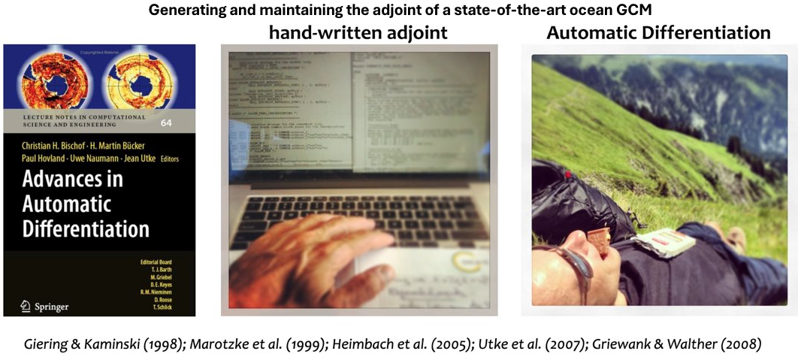
Why is Algorithmic Differentiation (AD) necessary?

Slide 17
Some more nuances (looking inside A)
y = A(x) = A_{N}(...(A₂(A₁(x))))
x₁ = A₁(x),
x_{i} = A_{i}(x_{i-1}) i = 2, …, N-1
y = A_{N}(x_{N-1})
δy = A(x) · δx = A_{N}(x_{N-1})....A₂(x₁)·A₁(x) · δx
∇ₓJ = A(x)ᵀ · ∇ᵧJ = A₁(x)ᵀ·A₂(x₁)ᵀ…A_{N}(x_{N-1})ᵀ · ∇ᵧJ
To keep things readable, let’s assume x is just initial conditions of an ocean model (no model parameters or boundary conditions). Let’s assume N time steps.
For notational convenience,
The Tangent Linear Model is given by:
The Adjoint Model is given by:

Slide 18
Some more nuances (looking inside A)
δy = A(x) · δx = A_{N}(x_{N-1})....A₂(x₁)·A₁(x) · δx
∇ₓJ = A(x)ᵀ · ∇ᵧJ = A₁(x)ᵀ·A₂(x₁)ᵀ…A_{N}(x_{N-1})ᵀ · ∇ᵧJ
ORDER OF COMPUTATION
The Tangent Linear Model is given by:
The Adjoint Model is given by:
ORDER OF COMPUTATION
The sequence of operations above is in our hands.
If we go from left to right, we have to keep doing matrix-matrix operations, if both matrices are MxM and we have N matrices, that’s about NM³ operations.
If we go from right to left, that is always hit the vector on the right with a matrix first, we are only doing about NM² operations.
N ~ 250,000 time steps and M ~ 500,000,000 parameters for ECCO
10^31 vs 10^23 floating point operations, that’s a significant difference!

Slide 19
Some more nuances (looking inside A)
δy = A(x) · δx = A_{N}(x_{N-1})....A₂(x₁)·A₁(x) · δx
ORDER OF COMPUTATION
The Tangent Linear Model is given by:
We need x first, followed by x₂, x₃, …, x_{N-1}
Also notice that the 1st timestep’s adjoint matrix is hitting the vector first and then all the other timesteps’ matrices hit it in the “expected” order.
This is perfectly fine, since this is the natural order of computation in our non-linear forward model anyways.

Slide 20
Some more nuances (looking inside A)
∇ₓJ = A(x)ᵀ · ∇ᵧJ = A₁(x)ᵀ·A₂(x₁)ᵀ…A_{N}(x_{N-1})ᵀ · ∇ᵧJ
The Adjoint Model is given by:
ORDER OF COMPUTATION
We need x_{N-1} first, followed by x_{N-2}, x_{N-3}, …,x₂, x₂, x.
This is reverse of the natural order of computation in our non-linear forward model or our general understanding of dependencies forward in time.
Also notice that the N-th timestep’s adjoint matrix is hitting the vector first and then all the other timesteps’ matrices hit it in the reverse order.
The adjoint model runs backwards in time!

Slide 21
Some more nuances (looking inside A)
∇ₓJ = A(x)ᵀ · ∇ᵧJ = A₁(x)ᵀ·A₂(x₁)ᵀ…A_{N}(x_{N-1})ᵀ · ∇ᵧJ
The Adjoint Model is given by:
ORDER OF COMPUTATION
The adjoint model runs backwards in time!
(Not shown here) The sign of the advection operator just reverses for the adjoint. If you were looking at an adjoint movie of the Gulf Stream it would be flowing from north to south.
INTUITION: The Gulf Stream is sending “information” to the poles, and you as a detective are watching the movie in reverse, tracing the "influence trail" back from the poles to figure out which earlier states or regions mattered most.

Slide 22
Storage using a tape (stack)
∇ₓJ = A(x)ᵀ · ∇ᵧJ = A₁(x)ᵀ·A₂(x₁)ᵀ…A_{N}(x_{N-1})ᵀ · ∇ᵧJ
The Adjoint Model is given by:
We need the states in the reverse order when computing the adjoint.
We have three options:
Run forward model, store all states (i.e. all the x’s) in memory and retrieve in reverse order (Tapenade by default).
Recompute the state we need from scratch every time we take one step to the left (TAF by default).
Something hybrid (checkpointing, classic tradeoff between memory and computation time).

Slide 23
Why Tangent Linear Model?
It would seem that the Tangent linear model is not useful when you have the adjoint model to compute the gradient in one go.
However, it has its uses:
Validation of the adjoint model (ideally should agree to around machine precision!)
Second-order optimization methods (Hessian contains the tangent linear model)
Uncertainty quantification (Hessian is inverse of the posterior covariance matrix)

Slide 24
ALGORITHMIC DIFFERENTIATION (AD)
PART II
Ian Fenty
Shreyas Gaikwad

Slide 25
Budyko-Sellers Energy Balance Model
Let’s now work with a small climate model!

Slide 26
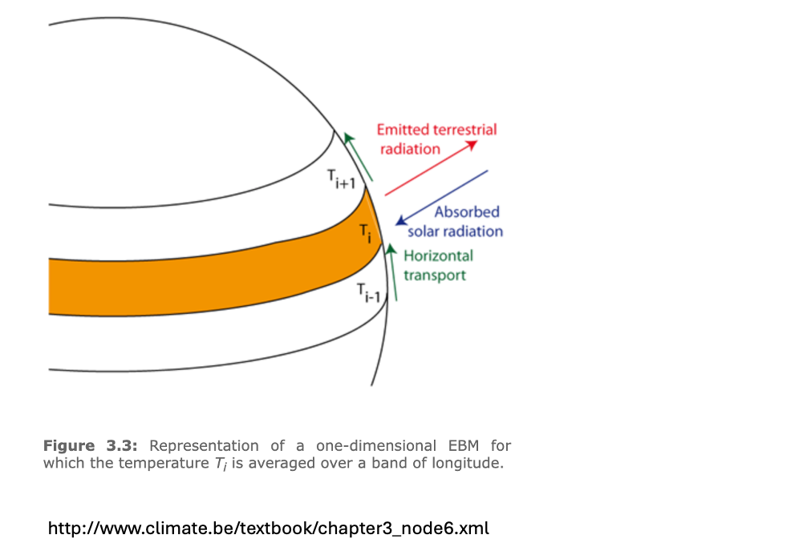
Budyko-Sellers Model
Observed temperature gradient between the equator and poles is a result of
Incoming solar insolation (tries to make equator much warmer than the poles)
Outgoing longwave radiation (local energy loss, damps temperature increases)
Heat transport by winds and oceans (tries to flatten the temperature gradient by flowing from equator to poles)
COOL the tropics
WARM the poles.
We are looking to model the equator-to-pole temperature difference.

Slide 27
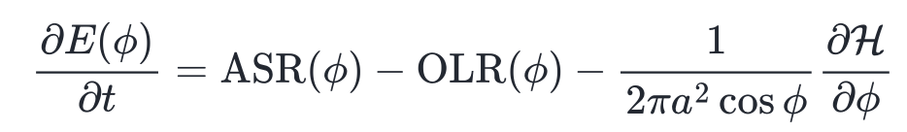
Budyko-Sellers Model local energy budget for each latitude
ASR: Absorbed solar radiation
OLR: Outgoing longwave radiation
H is the meridional heat transport

Slide 28
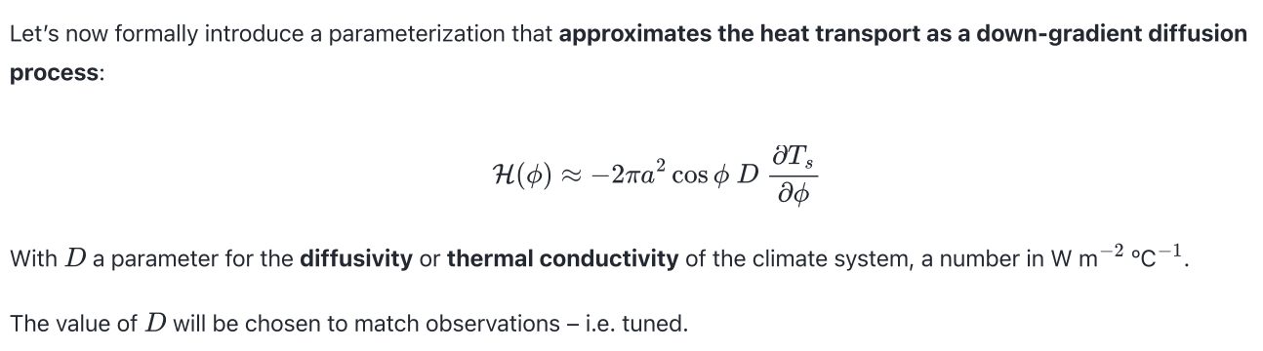
Modeling the heat transport

Slide 29
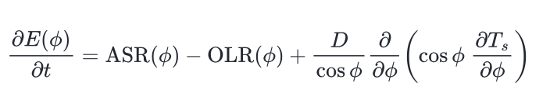
Budyko-Sellers Model local energy budget for each latitude
ASR: Absorbed solar radiation
OLR: Outgoing longwave radiation
The third term is diffusion in spherical coordinates.

Slide 30
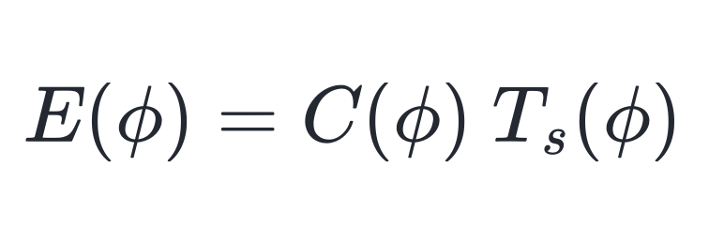
Modeling the energy content
Most of the heat is in the oceans.
Surface temperature is a good proxy for the heat content of the ocean column
C is the effective heat capacity of the ocean column. Function of latitude depending on fraction of ocean vs land can vary.
Ts is the surface temperature.

Slide 31
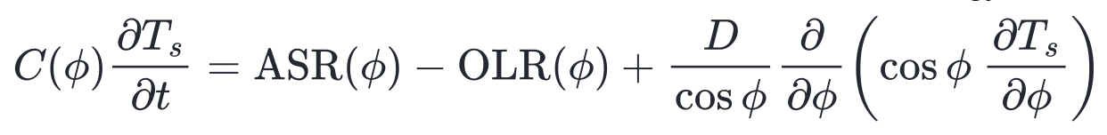
Budyko-Sellers Model local energy budget for each latitude
ASR: Absorbed solar radiation
OLR: Outgoing longwave radiation
The third term is heat diffusion in spherical coordinates.

Slide 32
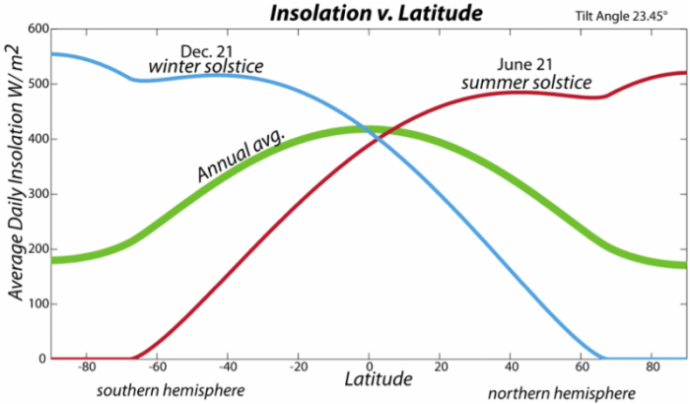
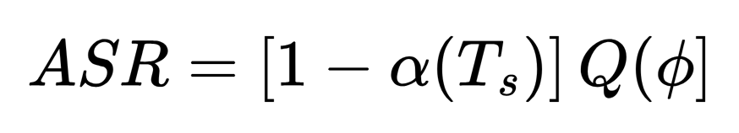
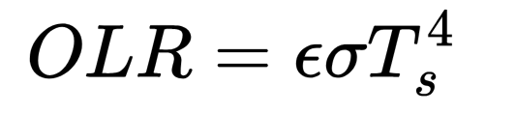
Modeling the Radiation terms
Albedo depends linearly on the temperature
Incoming heat Q depends on the latitude (sine of the latitude actually)
Stefan-Boltzmann law for outgoing longwave radiation

Slide 33
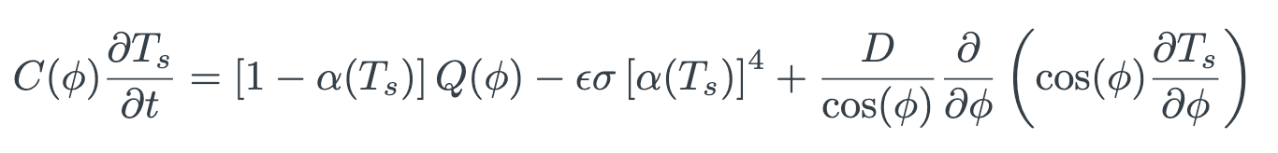
Budyko-Sellers Model local energy budget for each latitude

Slide 34
Let’s look at a pseudo-code

Slide 35
Initialize surface temperature to be a constant 290K (17C)
T(i) = 290 for all i in the latitude grid

Slide 36
Initialize surface temperature to be a constant 290K (17C)
T(i) = 290 for all i in the latitude grid
for t = 1..N
Incoming radiative flux [time-invariant, constant albedo assumed]
Fin(i) = sx(i)*(1.d0-alpha_const(i)) + xxs (control)

Slide 37
Initialize surface temperature to be a constant 290K (17C)
T(i) = 290 for all i in the latitude grid
for t = 1..N
Incoming radiative flux [time-invariant, constant albedo assumed]
Fin(i) = sx(i)*(1.d0-alpha_const(i)) + xxs (control)
Outgoing radiation
Fout(i) = epsilon*sigma* T(i)**4

Slide 38
Initialize surface temperature to be a constant 290K (17C)
T(i) = 290 for all i in the latitude grid
for t = 1..N
Incoming radiative flux [time-invariant, constant albedo assumed]
Fin(i) = sx(i)*(1.d0-alpha_const(i)) + xxs (control)
Outgoing radiation
Fout(i) = epsilon*sigma* T(i)**4
Meridional flux (simplified for brevity, central difference scheme)
Fdiff(i) = D*[ [ T(i+1) - 2T(i) +T(i-1)] ] / dx**2

Slide 39
Initialize surface temperature to be a constant 290K (17C)
T(i) = 290 for all i in the latitude grid
for t = 1..N
Incoming radiative flux [time-invariant, constant albedo assumed]
Fin(i) = sx(i)*(1.d0-alpha_const(i)) + xxs (control)
Outgoing radiation
Fout(i) = epsilon*sigma* T(i)**4
Meridional flux (simplified for brevity, central difference scheme)
Fdiff(i) = D*[ [ T(i+1) - 2T(i) +T(i-1)] ] / dx**2
Update T (Assume C = 1)
Tnew(i) = T(i)+ dt*[Fin(i)-Fout(i)+Fdiff(i)]
end

Slide 40
Initialize surface temperature to be a constant 290K (17C)
T(i) = 290 for all i in the latitude grid
for t = 1..N
Incoming radiative flux [time-invariant, constant albedo assumed]
Fin(i) = sx(i)*(1.d0-alpha_const(i)) + xxs (control)
Outgoing radiation
Fout(i) = epsilon*sigma* T(i)**4
Meridional flux (simplified for brevity, central difference scheme)
Fdiff(i) = D*[ [ T(i+1) - 2T(i) +T(i-1)] ] / dx**2
Update T (Assume C = 1)
Tnew(i) = T(i)+ dt*[Fin(i)-Fout(i)+Fdiff(i)]
end
J = f(Tnew) = Tnew(equator) - Tnew(poles)

Slide 41
Before we go into the real code
Let’s differentiate a line of code by hand

Slide 42
Initialize surface temperature to be a constant 290K (17C)
T(i) = 290 for all i in the latitude grid
for t = 1..N
Incoming radiative flux [time-invariant, constant albedo assumed]
Fin(i) = sx(i)*(1.d0-alpha_const(i)) + xxs (control)
Outgoing radiation
Fout(i) = epsilon*sigma* T(i)**4
Meridional flux (simplified for brevity, central difference scheme)
Fdiff(i) = D*[ [ T(i+1) - 2T(i) +T(i-1)] ] / dx**2
Update T (Assume C = 1)
Tnew(i) = T(i)+ dt*[Fin(i)-Fout(i)+Fdiff(i)]
end
J = f(Tnew) = Tnew(equator) - Tnew(poles)

Slide 43
Initialize surface temperature to be a constant 290K (17C)
T(i) = 290 for all i in the latitude grid
for T = 1..n
Incoming radiative flux [time-invariant, constant albedo assumed]
Fin(i) = sx(i)*(1.d0-alpha_const(i)) + xxs (control)
Outgoing radiation
Fout(i) = epsilon*sigma* T(i)**4
Meridional flux (simplified for brevity, central difference scheme)
Fdiff(i) = D*[ [ T(i+1) - 2T(i) +T(i-1)] ] / dx**2
Update T
Tnew(i) = T(i)+ dt*[Fin(i)-Fout(i)+Fdiff(i)]
end
J = f(Tnew) = Tnew(equator) - Tnew(poles)

Slide 44
REMINDER ON WHAT TLM DOES
y = x, J = y²
∴ δy = δx and δJ = 2yδy
In 1D, only one unit vector δx = 1.
∴ δy = 1 and δJ = 2y = 2x
∴ 2x is our directional derivative (precise).
TLM (Method 2) employs the chain rule to linearize the non-linear forward model line-by-line. It then propagates small perturbations through the linearized model equations to get the precise directional derivative.

Slide 45
AD tool’s modification of source code to generate TLM
Source Code (T(i) coming from upstream)
Fout(i) = epsilon*sigma* T(i)**4
AD generated TLM Code (T(i), T_tl(i) coming from upstream)
Fout(i) = epsilon*sigma* T(i)**4 (OG non-linear forward code)
Fout_tl(i) = 4*epsilon*sigma* T(i)**3*T_tl(i) (Propagating pertubations)
Observations:
For many lines of non-linear forward code, you have 2 lines in the TLM code each.
Some lines may not be differentiated because there’s nothing “active” in them.
The TLM code has slightly less than 2x the lines of the non-linear forward code.
It is thus slightly less than 2x times slower.
NOTE: var_tl means δvar in terms of the math.

Slide 46
AD tool’s modification of source code to generate TLM
AD generated TLM Code (T(i), T_tl(i) coming from upstream)
Fout(i) = epsilon*sigma* T(i)**4 (OG non-linear forward code)
Fout_tl(i) = 4*epsilon*sigma* T(i)**3*T_tl(i) (Propagating pertubations)
Matrix form of TLM
| Fout_tl(i) |_{new} = | 0 4*epsilon*sigma*T_{old}(i)**3| | Fout_tl(i) |_{old}
| T_tl(i) |_{new} = | 0 1 | | T_tl(i) |_{old}
HELPFUL TIP: Think of every single line of forward code as its own mini-model.
NOTE: var_tl means δvar in terms of the math.

Slide 47
REMINDER ON WHAT THE ADJOINT MODEL IS
y = A(x); J = f(y)
∇ₓJ = (∂A/∂x)ᵀ · ∇ᵧJ = A(x)ᵀ · ∇ᵧJ
HARD
TO GET
TRIVIAL
Characteristics:
Precise.
Gradient computed in one adjoint pass.
Can be 5-100 times slower than the non-linear forward model (still better than running the non-linear forward model millions of times).

Slide 48
AD tool’s modification of source code to generate Adjoint
Source Code
Fout(i) = epsilon*sigma* T(i)**4
Matrix form of Adjoint (Transpose of TLM)
| Fout_ad(i) |_{new} = | 0 0 | | Fout_ad(i) |_{old}
| T_ad(i) |_{new} = | 4*epsilon*sigma*T_{old}(i)**3 1 | | T_ad(i) |_{old}
Transpose of TLM matrix i.e. A^{T}
NOTE:
You should always read var_ad in your mind as ∂J/∂var (and not as something proportional or equivalent to var itself).
Always write down the tangent linear model first and then take the transpose to get the adjoint.

Slide 49
AD tool’s modification of source code to generate Adjoint
LET’S LOOK A BIT MORE CLOSELY
| Fout_ad(i) |_{new} = | 0 0 | | Fout_ad(i) |_{old}
| T_ad(i) |_{new} = | 4*epsilon*sigma*T_{old}(i)**3 1 | | T_ad(i) |_{old}
We know that the adjoint runs reverse in time, so if the do loop in the forward code ran from 1 to N, the adjoint runs from N to 1.
This means we actually don’t have T_{old}(i)!
We need to store it when we are running the forward code then and then retrieve it for use here (Tapenade). Or we have to compute it somehow (TAF).

Slide 50
AD tool’s modification of source code to generate Adjoint
| Fout_ad(i) |_{new} = | 0 0 | | Fout_ad(i) |_{old}
| T_ad(i) |_{new} = | 4*epsilon*sigma*T_{old}(i)**3 1 | | T_ad(i) |_{old}
Source Code
AD generated Adjoint Code
Do t = 1, T
Do i = 1, N
… BEFORE …
Fout(i) = epsilon*sigma* T(i)**4
STORE(T(i)) # save T_old
… AFTER (T updated)…
End do
End do
Do t = T, 1, -1
Do i = N, 1, -1
… AFTER_AD (T_new is available but we need T_old) …
RETRIEVE(T(i)) # get T_old
T_ad(i) = 1*T_ad(i) + 4*epsilon*sigma*T(i)**3*Fout_ad(ad)
Fout_ad(i) = 0*T_ad(i)+0*Fout_ad(ad) = 0
… BEFORE_AD …
End do
End do
Do t = 1, T
Do i = 1, N
… BEFORE …
Fout(i) = epsilon*sigma* T(i)**4
… AFTER (T(i) updated)…
End do
End do
The sequence matters!!

Slide 51
Differentiating Budyko-Sellers model in Fortran-77
Using TAF and Tapenade

Slide 52
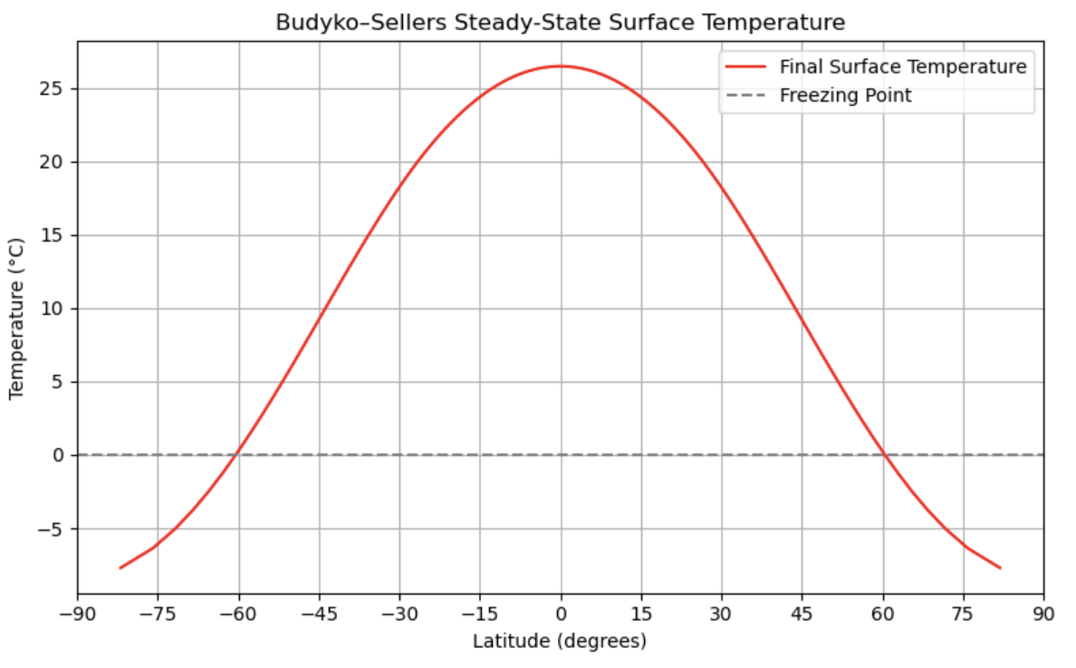
Forward model results (E2P delta_T = 34 C)

Slide 53
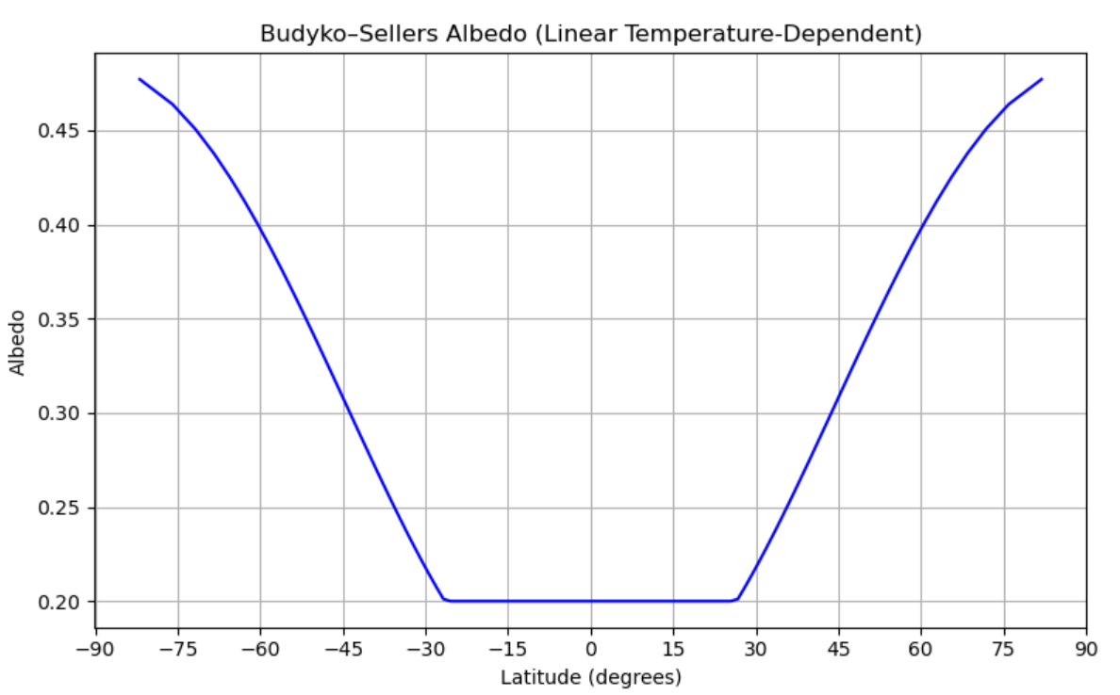
Forward model results (E2P delta_T = 34 C)

Slide 54
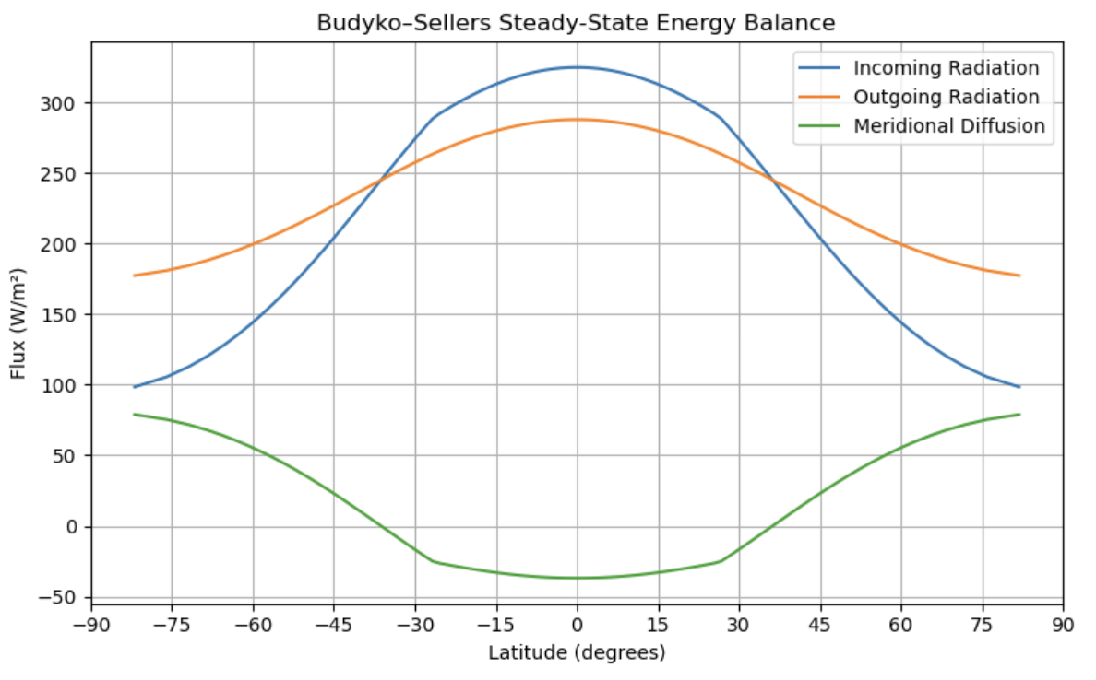
Forward model results (E2P delta_T = 34 C)

Slide 55
Task 1: Validate our gradients
Using TAF and Tapenade

Slide 56
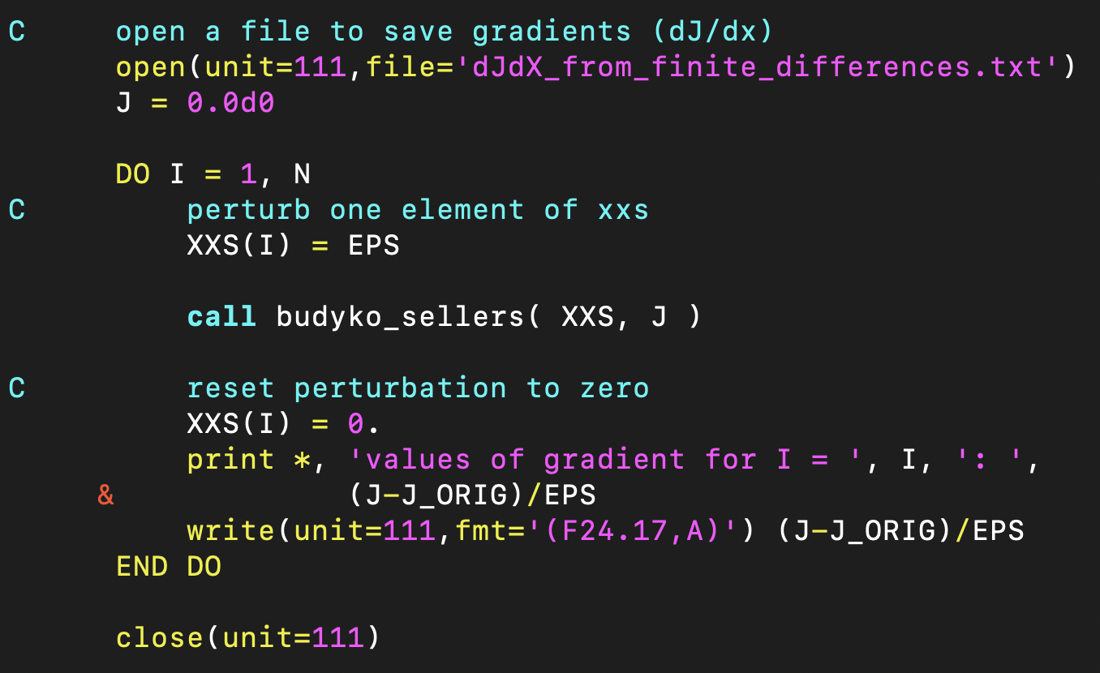
Finite differences
budyko_sellers takes in vector xxs (control) and computes scalar J (QoI)
∂J/∂xᵢ ≈ [f(A(xᵢ⁺)) - f(A(x))] / ε + O(ε)

Slide 57
Tangent linear code
budyko_sellers takes in vector xxs (control) and computes scalar J (QoI)
budyko_sellers_tl takes in vector xxs (control), xxs_tl and computes scalar J (QoI), J_tl
Let’s look at the line we differentiated by hand earlier, in the generated code budyko_sellers_tl
Fout(i) = epsilon*sigma* T(i)**4 (OG non-linear forward code)
Fout_tl(i) = 4*epsilon*sigma* T(i)**3*T_tl(i) (Propagating pertubations)

Slide 58
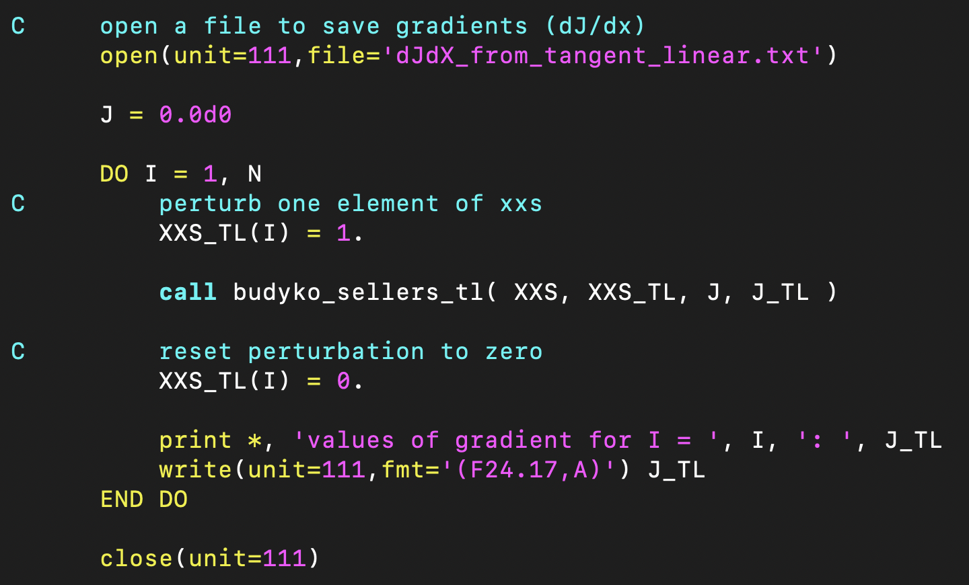
Tangent linear code
budyko_sellers takes in vector xxs (control) and computes scalar J (QoI)
budyko_sellers_tl takes in vector xxs (control), xxs_tl and computes scalar J (QoI), J_tl
Let’s look at the do loop to compute the gradient

Slide 59

Tapenade adjoint code
Do t = 1, T
Do i = 1, N

Slide 60
Tapenade adjoint code
Do t = 1, T
Do i = 1, N
… BEFORE …
Fout(i) = epsilon*sigma* T(i)**4

Slide 61
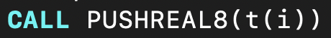
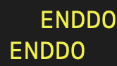
Tapenade adjoint code
Do t = 1, T
Do i = 1, N
… BEFORE …
Fout(i) = epsilon*sigma* T(i)**4
STORE(T(i)) # save T_old
… AFTER (T updated)…
End do
End do

Slide 62
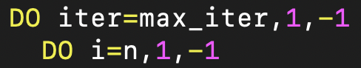
Tapenade adjoint code
Do t = 1, T
Do i = 1, N
… BEFORE …
Fout(i) = epsilon*sigma* T(i)**4
STORE(T(i)) # save T_old
… AFTER (T updated)…
End do
End do
Do t = T, 1, -1
Do i = N, 1, -1

Slide 63
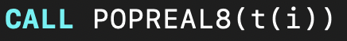
Tapenade adjoint code
Do t = 1, T
Do i = 1, N
… BEFORE …
Fout(i) = epsilon*sigma* T(i)**4
STORE(T(i)) # save T_old
… AFTER (T updated)…
End do
End do
Do t = T, 1, -1
Do i = N, 1, -1
… AFTER_AD (T_new is available but we need T_old) …
RETRIEVE(T(i)) # get T_old

Slide 64
Tapenade adjoint code
Do t = 1, T
Do i = 1, N
… BEFORE …
Fout(i) = epsilon*sigma* T(i)**4
STORE(T(i)) # save T_old
… AFTER (T updated)…
End do
End do
Do t = T, 1, -1
Do i = N, 1, -1
… AFTER_AD (T_new is available but we need T_old) …
RETRIEVE(T(i)) # get T_old
T_ad(i) = 1*T_ad(i) + 4*epsilon*sigma*T(i)**3*Fout_ad(ad)
Fout_ad(i) = 0*T_ad(i)+0*Fout_ad(ad) = 0
… BEFORE_AD …
End do
End do

Slide 65
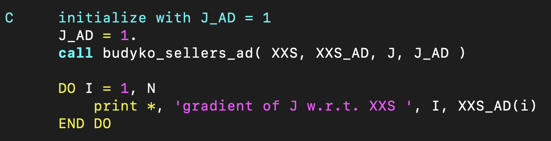
Tapenade adjoint code
budyko_sellers takes in vector xxs (control) and computes scalar J (QoI)
budyko_sellers_ad takes in vector xxs (control), J_ad and computes scalar J (QoI), xxs_ad
budyko_sellers_ad computes the gradient in one pass, no do loop needed.
You should always read var_ad in your mind as ∂J/∂var (and not as something proportional or equivalent to var itself).
J_ad = 1 is therefore just ∂J/∂J = 1. Needed to spinup the adjoint.

Slide 66
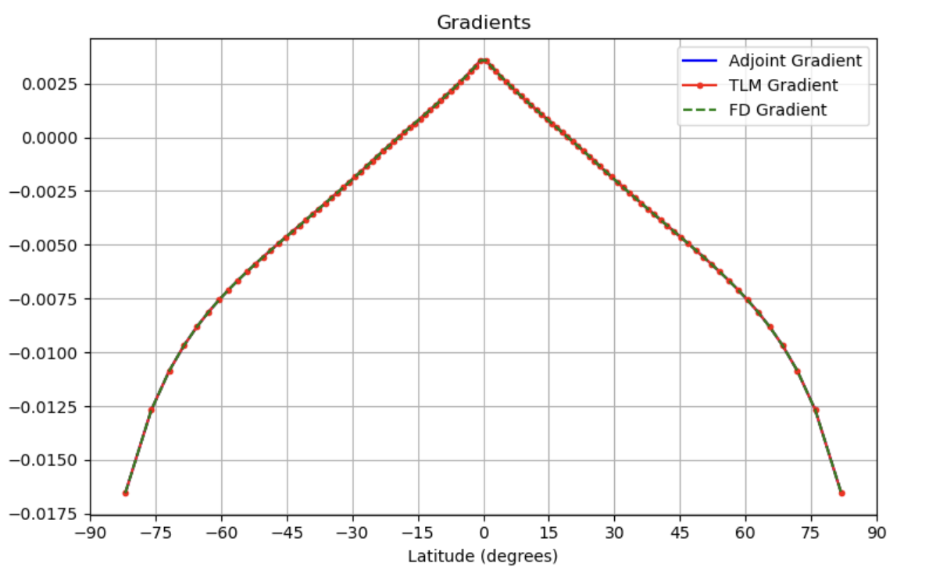
Gradients

Slide 67
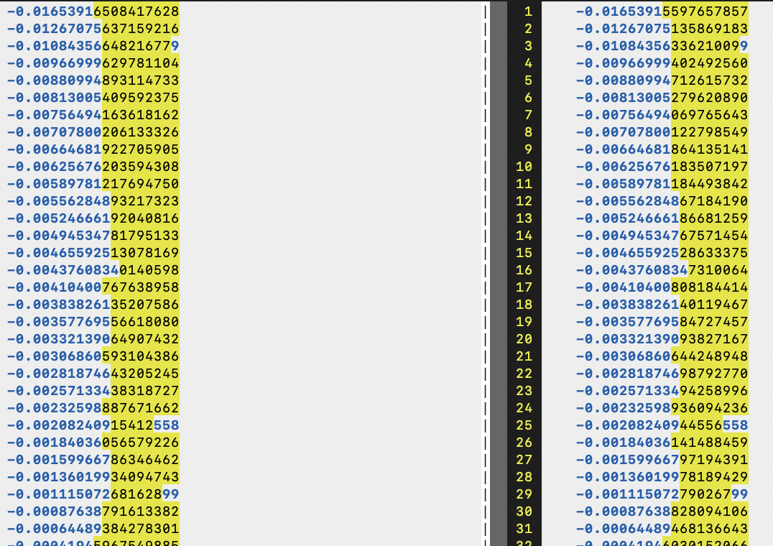
FD vs TLM gradients

Slide 68
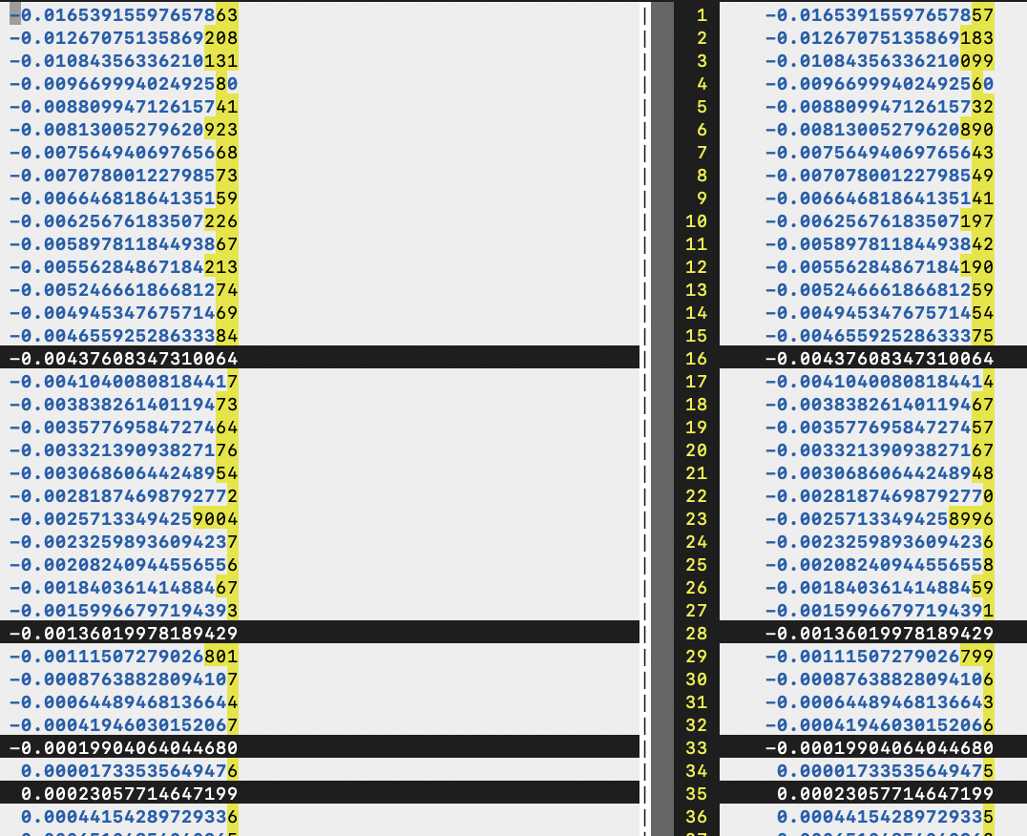
Adjoint vs TLM gradients

Slide 69
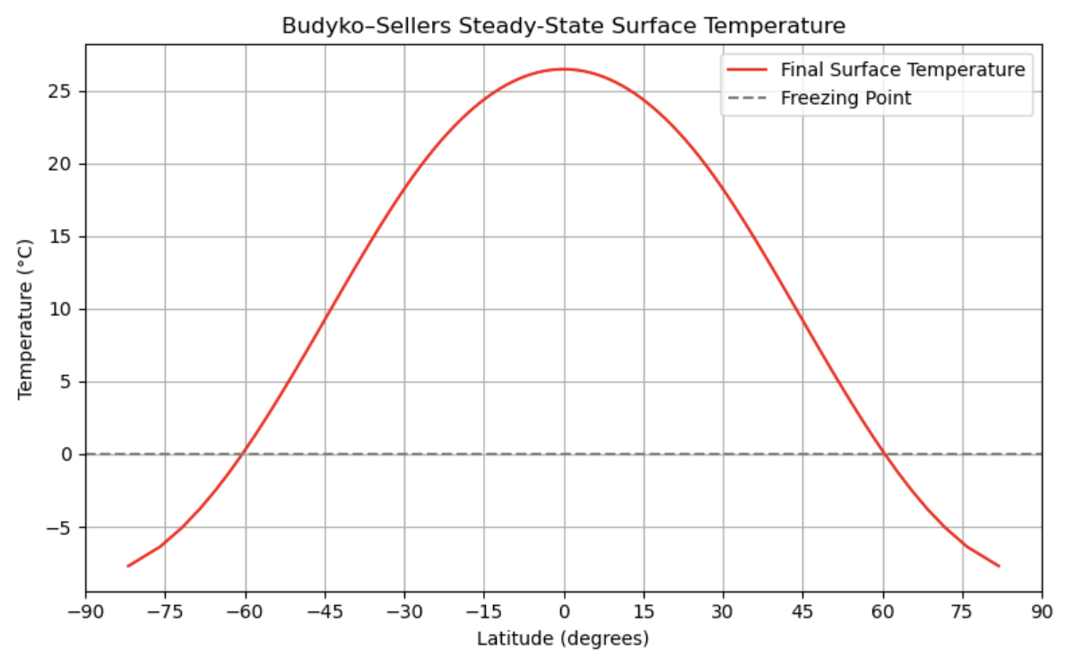
State Estimate
For D=0.6, the equator-to-pole temperature difference is 34.16 deg Celcius.
We know that the real value of the equator-to-pole temperature difference is 45 deg Celcius.

Slide 70
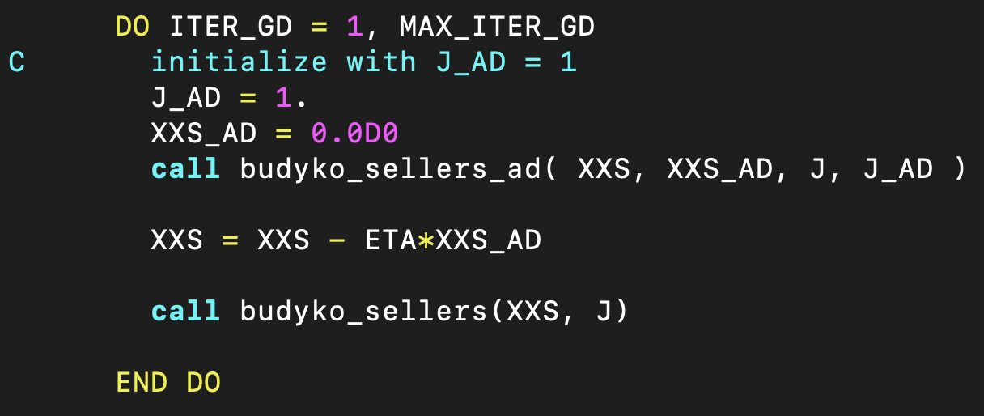
Basics of State Estimation
J = (ΔT_{m} - ΔT_{d})²
Drive a model-data misfit to zero using optimization methods.
In this case, our cost function is (m: Model, d: Data)
Our independent variable is the diffusion coefficient D.
We use steepest descent to drive this cost function down to 0.

Slide 71
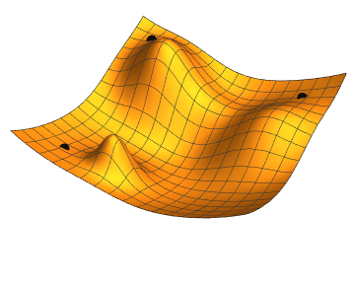
Steepest descent

Slide 72
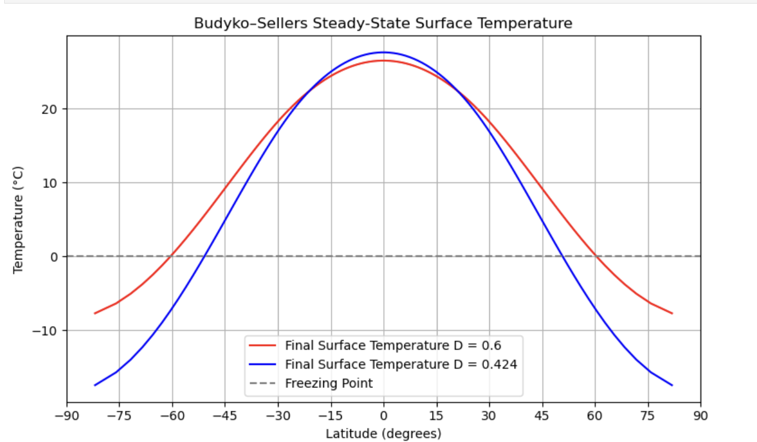
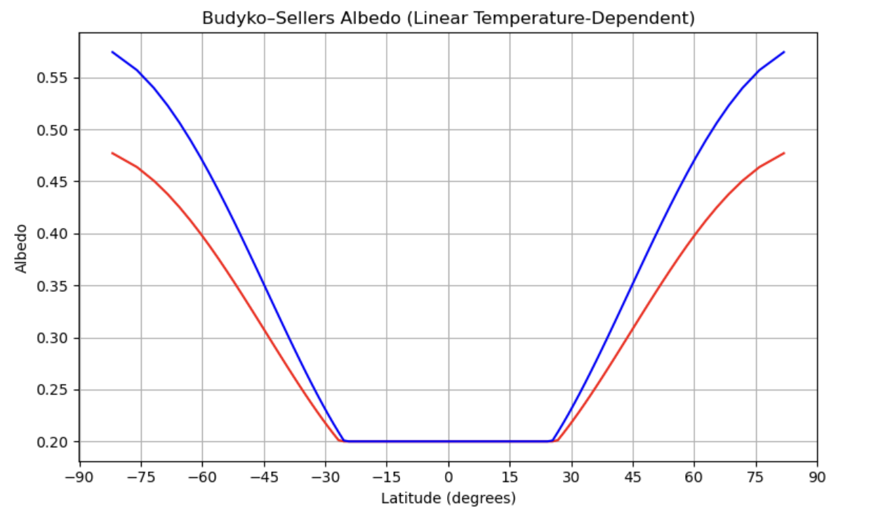
Tuned results

Slide 73
TAF adjoint code

Slide 74
TAF vs Tapenade
For this super simple simulation, everything fits in memory, so we should not be recomputing anything.
Tapenade is store-all by default. The tape is initialized and stacked and popped as a default setting.
TAF is recompute-all by default. Therefore, we need to tell it to store everything in memory instead of recomputing everything. You will see the following comments sprinkled in the code
For N time steps, TAF recomputes every i-th T starting from 1 repeatedly. Since our convergence to steady state takes 80,000 time steps, TAF is actually taking 3.2 billion time steps.
Start of code:
CADJ INIT tapex = 'TAF_tape'
Inside time loop:
CADJ STORE t = tapex
These are comments in F-77 but they are also directives for TAF.

Slide 75
TAF adjoint code

Slide 76
Thank you!

Slide 77
A glimpse into utility of TLM and adjoint for UQ

Slide 78
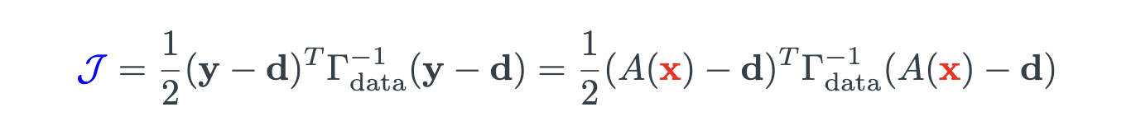
A glimpse into Uncertainty Quantification

Slide 79
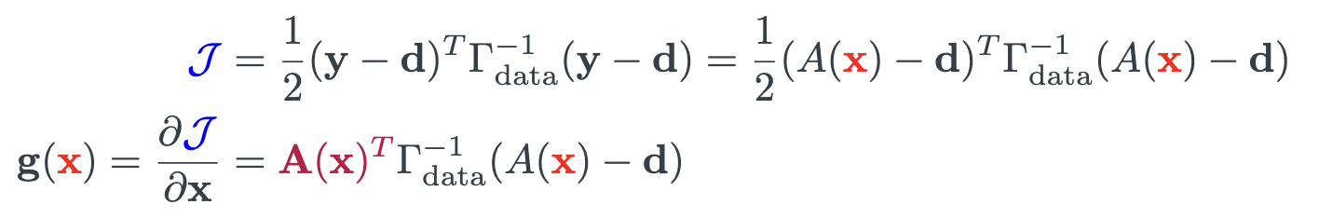
A glimpse into Uncertainty Quantification

Slide 80
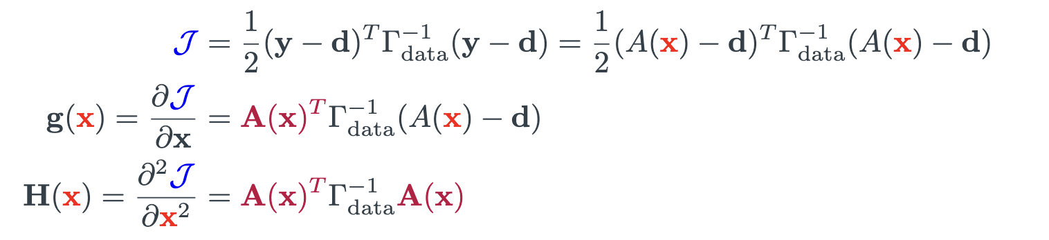
A glimpse into Uncertainty Quantification

Slide 81
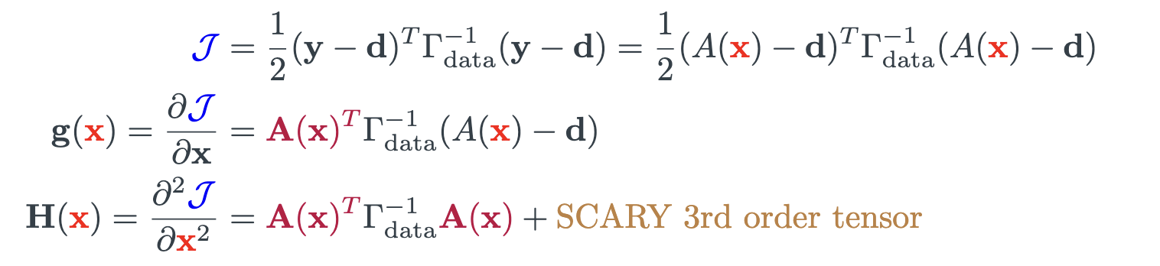

A glimpse into Uncertainty Quantification

Slide 82
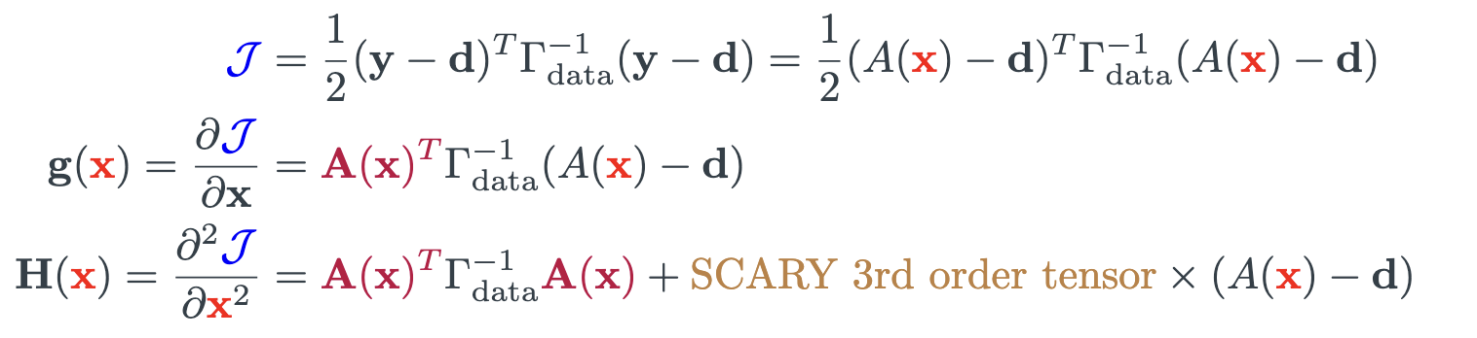
A glimpse into Uncertainty Quantification

Slide 83
A glimpse into Uncertainty Quantification
Adjoint
TLM

Slide 84
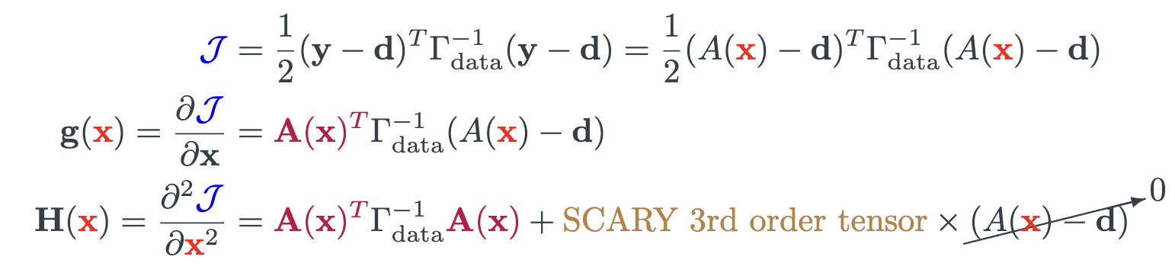
A glimpse into Uncertainty Quantification
Adjoint
TLM
Gauss-Newton approximation

Slide 85
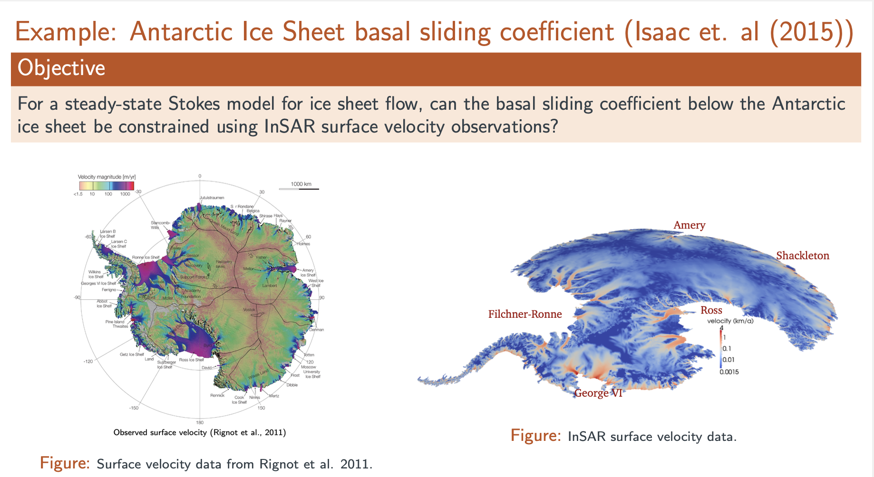

Slide 86
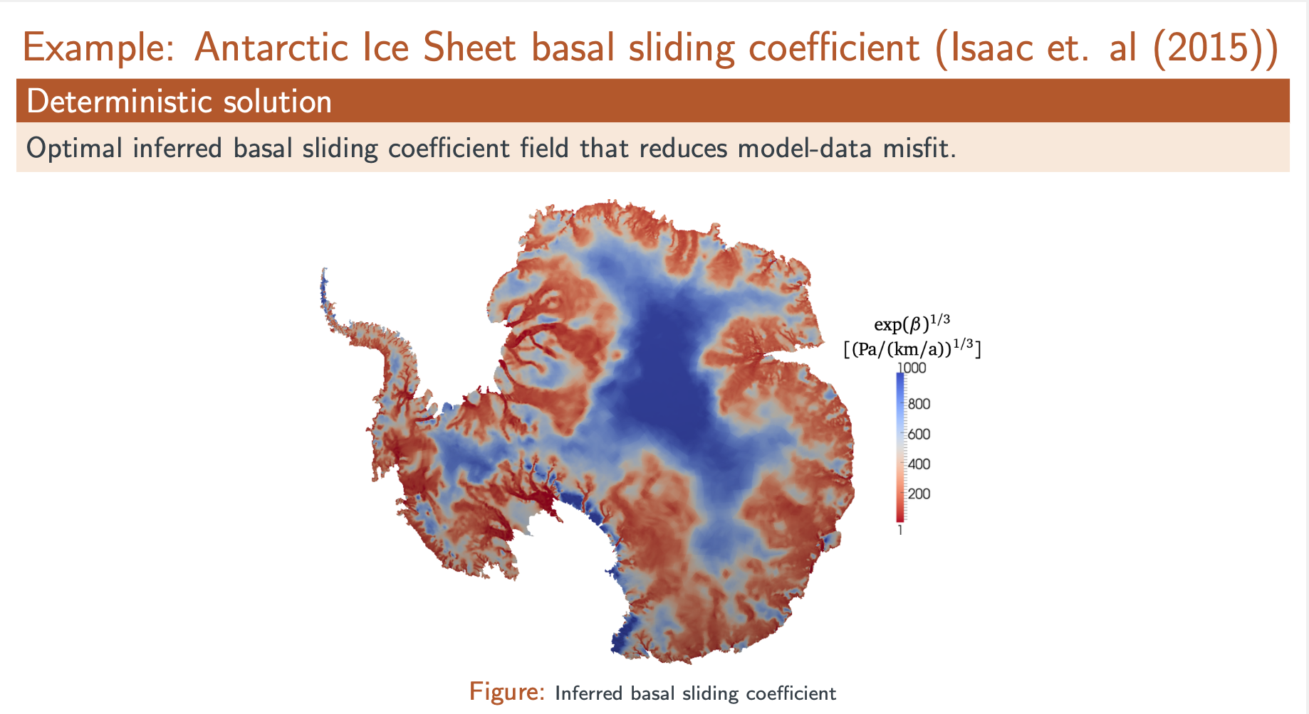

Slide 87
